Slide 1




p
Introduction
Prashik Ganesh Gawai
(Professional Program in Data Analytics with GenAI-71)
Mentor Name : Ashish Rajput Sir (NIIT)
Project Type : MySQL Project

Slide 2


p
Data Description
Project Name :- Student Academic Tracker – Database Project Presentation
Industry :- Education
Using
Command :- (DDL, DML, DQL, Join Query, Aggregate Function, Subquery, Indexing, Stored Procedures, Views, Triggers, JSON Concept, Commit, Rollback)
Using Tool
    MySQL =

Slide 3
Objectives
Objectives :
Objective 1: Database Creation and Data Handling
Objective 2: Use of SQL Functions and Operators
Objective 3: Data Retrieval and Advanced Queries
Objective 4: Advanced Database Concepts

Slide 4
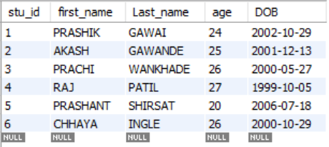
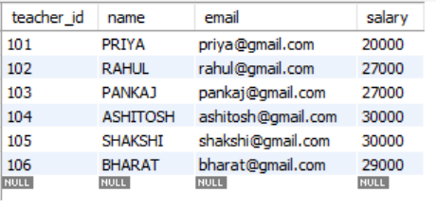
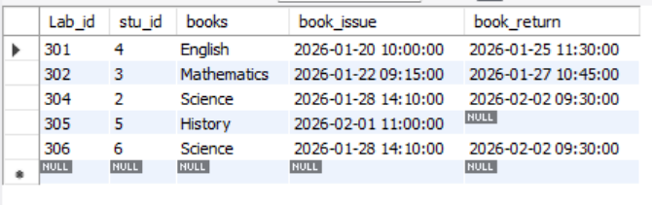
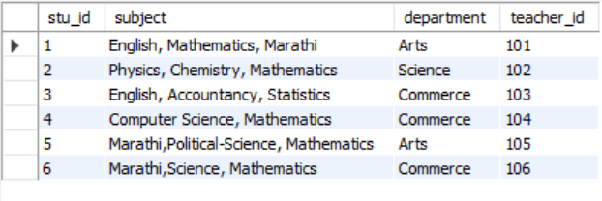
Objective :- 1 (Creation of Tables)
Table of Student
Table of Teacher
Table of Library
Table of Student_subject

Slide 5
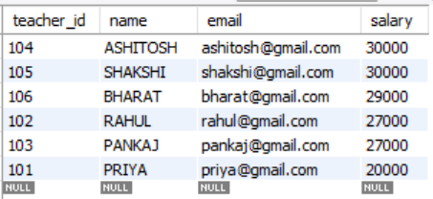
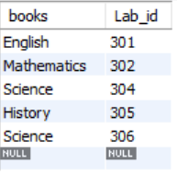
Objective :- 2 (Data Sorting and Selection)
Find out the Teacher salary in Descending order?
What want to see the book and lab_id from the Library Table
With the help of salary in descending order we find out the maximum salary of the Teacher is “Ashitosh” with ₹ 30000.
By using query we find out the books and lab_id and there are total 5 books In the table

Slide 6
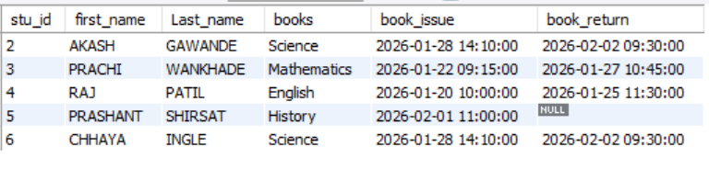
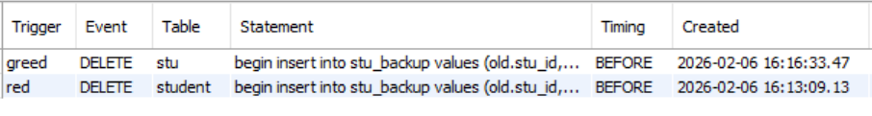
Objective :- 3 (Data Relationship Understanding)
We want to find out two table with specific columns with the help of Join Concept
As we can see there are two table of Trigger before deleting the value in rows

Slide 7
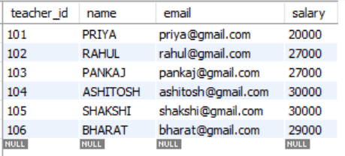




Objective :- 4 (Secure & Reliable Transactions)
In salary transaction use commit concept
In salary transaction use Rollback concept
With the help of commit concept we deduct the amount from Pankaj deduct
(₹-2000) and Ashitosh credit (₹+2000)
With the help of Rollback we get the ₹5000 money back from Ashitosh

Slide 8
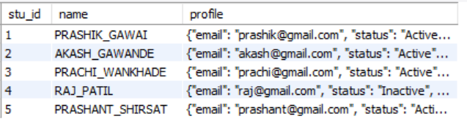
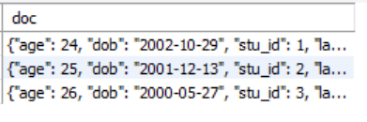
Objective :- 4 (Flexible Data Storage)
Create the table with id,name and profile with json
Create the doc_table with id,name and profile with json
As we can see creation of table with json with other two column
As we can see creation of doc_table with only json

Slide 9
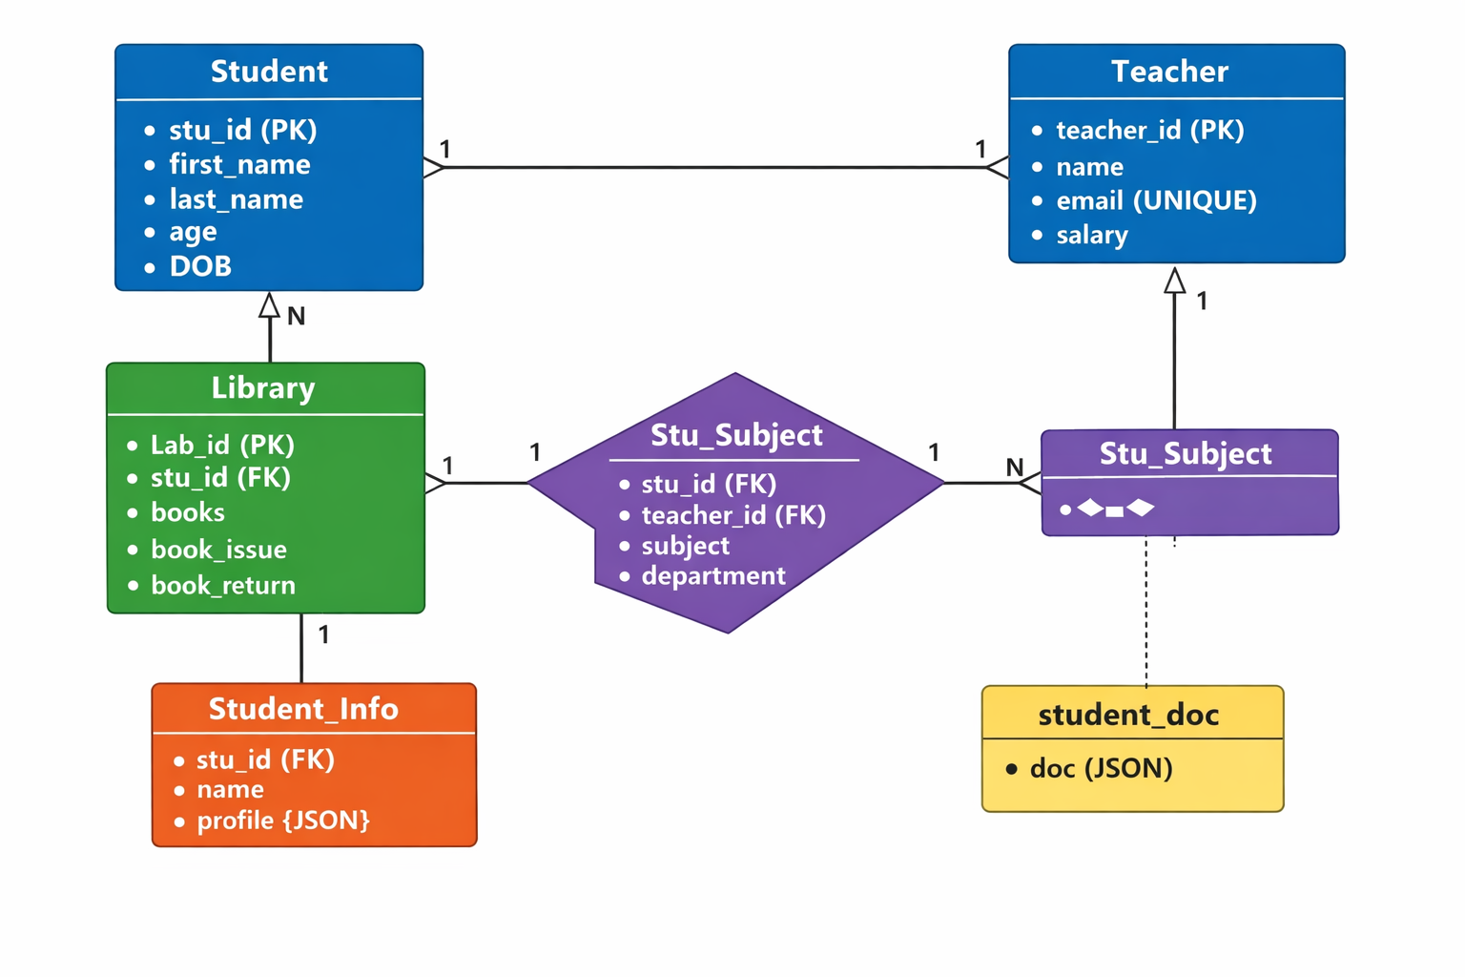
ER - DIAGRAM

Slide 10
Objectives | Tasks | Approach
Objective -1 | Task 1 – creation of Table & insert values Task 2 – Modify the Tables with constraints Task 3 – Add the new column and update it Task 4 - Delete unwanted data from the row | Create table t_name(Text Datatype); Alter table t_name add constraints ; Alter table t_name add _col col_name; Delete from t_name where condition;
Objective - 2 | Task 1 - using Aggregate function on the Tables Task 2 – using Arithmetic Operators on the Tables Task 3 – using Logical Operators on the Tables Task 4 – using Comparison Operators on the Tables | Select sum(col) from t_name; Select * from t_name where age+1= val; Select * from t_name where (and,or, between ) condition; Select * from t_name where con.with’ >=‘;
Objective - 3 | Task 1 - find the Asencding & Descending values of the Tables Task 2 – By using (Group By, Limit) find out the value of the Tables Task 3 – Join two or more table with the help of Join concept Task 4 – use Stored procedures | Select t_name where con. Order by __; Select t_name where con.group by,limit; Select t1_col1,t2_col1 from t_name join other t_name on common column; Call info_namegiven ;
Objective – 4 | Task 1 – use Trigger concept before delete on table for each row Task 2 – For salary use commit & Rollback concept Task 3 – Create table with the help of JSON Task 4 – Create table DOC who behaves like a No-SQL collection | Show triggers Commit; Rollback; Select doc from t_name

Slide 11
Summery
The project is based on an Education Industry database system.
Created tables like Student, Teacher, Library, Student_Subject.
Used SQL commands such as DDL, DML, and DQL for data management.
Applied sorting, functions, and operators to analyze teacher salary and library data.
Used JOIN queries to understand relationships between tables.
Implemented Triggers for automatic database actions.
Demonstrated COMMIT and ROLLBACK for secure transactions.
Applied advanced concepts like Stored Procedures, Views, Subqueries, and Indexing.
Used JSON data type for flexible data storage.

Slide 12
Conclusion
The project shows practical use of MySQL in academic data management.
Database structure improves organization and data accuracy.
Advanced SQL features increase automation and performance.
Transaction control ensures secure and reliable operations.
JSON support makes the system more flexible for modern data needs.
Overall, it demonstrates strong database design and real-world application skills.

